Slide 1
Data requirements for stochastic solvers
H.I. Gassmann
Dalhousie University
Halifax, Canada
Notes:
This talk explores several algorithms for stochastic programming and their requirements in form of data that must be made available (for instance, from an algebraic modelling language) to support these algorithms. This has implications for the design of AMLs
Thank Jun Ma and Kipp Martin for urging me to attend this meeting, Bob Fourer for putting me on the program (last email I have from him finalizing everything was time stamped 24 December 13:00) and all of the other speakers for being so accommodating and donating some of their time.

Slide 2
Overview
Introduction
Algorithms
Data structures
Conclusions

Slide 3
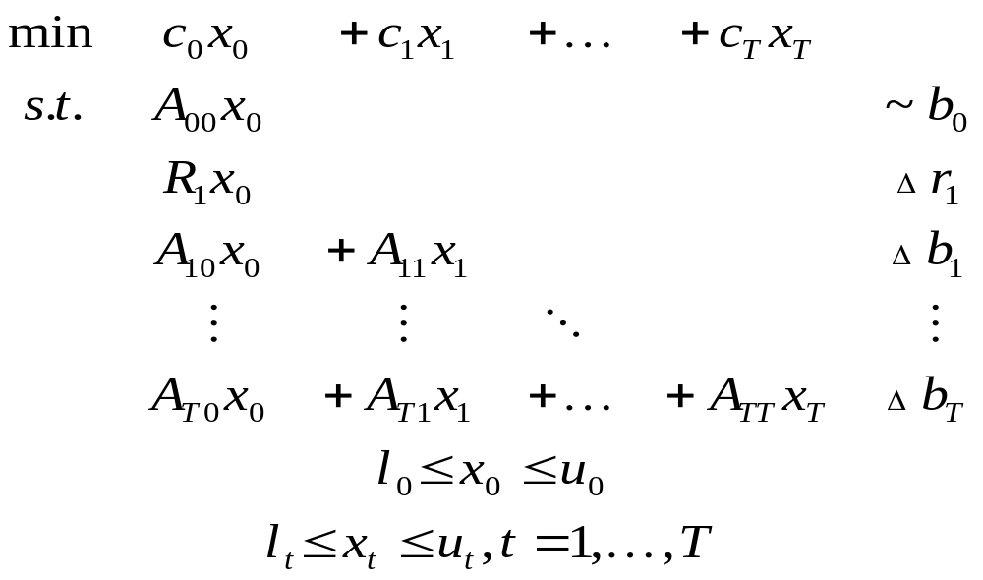
Multistage stochastic linear program
Any data item with nonzero subscript may be random
(including dimensions where mathematically sensible)
~ stands for arbitrary relation (≤, =, ≥)

Slide 4
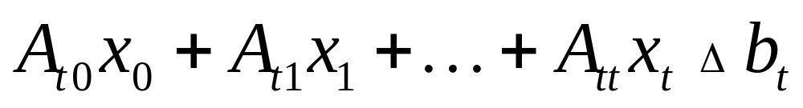
Constraints involving random elements
Δ means ~ with probability 1
or with probability at least β
or with expected violation at most v
Notes:
Probability 1: Deterministic constraint or almost surely
Probability β: Probabilistic constraint (VaR)
Expected violation: CVaR

Slide 5
Problem classes
Recourse problems
  All constraints hold with probability 1
Chance-constrained problems
  Typically single stage
Hybrid problems
  Recourse problems including probabilistic constraints (VaR) or integrated chance constraints (CVaR)
  Regulatory necessity
  Often modelled using integer variables and/or linking constraints

Slide 6
Algorithms
Direct solution of the deterministic equivalent
  “Curse of dimensionality”
Decomposition
  Recognize structure
  Repeated calls to solver with different data
  Sampling of scenarios during algorithm
    stochastic decomposition
    successive approximation
    “EVPI relaxation”
  Scenario generator between AML and solver
Notes:
Structure in stochastic programs is both temporal and stochastic (ie., two-dimensional in tree format)

Slide 7
Data Structures
Often O(10⁶) variables and constraints
Most compact representation possible
  Packed matrix format is insufficient
  Blocks corresponding to nodes in the event tree
  Change blocks if problem dimensions are deterministic
  A_{stj} = A_{st0} + ΔA_{stj} (addition or replacement)
Notes:
Change blocks cannot be used if the problem dimensions are stochastic (e.g., some decisions are not available if adverse events have happened)

Slide 8
Conclusions
Stochastic extensions are difficult
Time is right

